Slide 1
IoT-Based Smart Energy
Monitoring System Using ESP32
Dustin Bloss
ETEC-495 Seminar Project · Spring 2026
Advisor: Professor Lazaros Pavlidis · May 6, 2026

Slide 2
Project Overview
What is it?
An IoT-based system that measures real-time electrical energy consumption using an ESP32 microcontroller. It reads voltage and current through the ACS712 sensor and PZEM-004T module, calculates power and energy, displays the data on a 20×4 LCD screen, and sends readings to the ThingSpeak cloud dashboard over Wi-Fi.
Measure
Display
Transmit
Voltage, current, power (W) & energy (Wh) using ACS712 + PZEM-004T
Live readings on a 20×4 LCD screen, updated every 500ms via I2C
Data sent to ThingSpeak cloud over Wi-Fi every 15 seconds

Slide 3
Hardware Components
ESP32 Dev Board
ACS712 Current Sensor (30A)
The brain of the system. A small microcontroller with built-in Wi-Fi. Runs all the code — reads sensors, calculates power, drives the LCD, and pushes data to the cloud.
Measures current using a magnetic field (Hall effect) — no need to cut the wire. Outputs a small analog voltage that the ESP32 reads on GPIO35 to determine how many amps are flowing.
Voltage Divider (R1=100kΩ, R2=10kΩ)
PZEM-004T v3.0
Two resistors that scale a higher voltage down to 0–3.3V — the safe range for the ESP32 ADC. Without this, the ESP32 input pin would be damaged by higher voltages.
A dedicated energy metering module, far more accurate than basic sensors. Measures AC voltage, current, watts, and kilowatt-hours. Communicates with the ESP32 over UART serial.
20×4 LCD Display (I2C)
Hi-Link HLK-5M05
A 20-column by 4-row character screen showing live readings locally. Uses only 2 wires (SDA + SCL) via I2C protocol through a small backpack adapter on the back of the display.
An AC-to-DC power module that plugs straight into 120V mains and outputs clean 5V DC. Powers the ESP32 and all other modules — no separate wall adapter needed.
CT Clamp (Current Transformer)
Breadboard + Jumper Wires
A clip-on sensor that wraps around a live wire without cutting it. Detects the magnetic field from current flow and feeds a proportional signal into the ACS712 sensor.
Used for prototyping without soldering. Components and wires press into holes to make connections. Color-coded jumpers (red = power, black = ground) keep wiring organized.

Slide 4
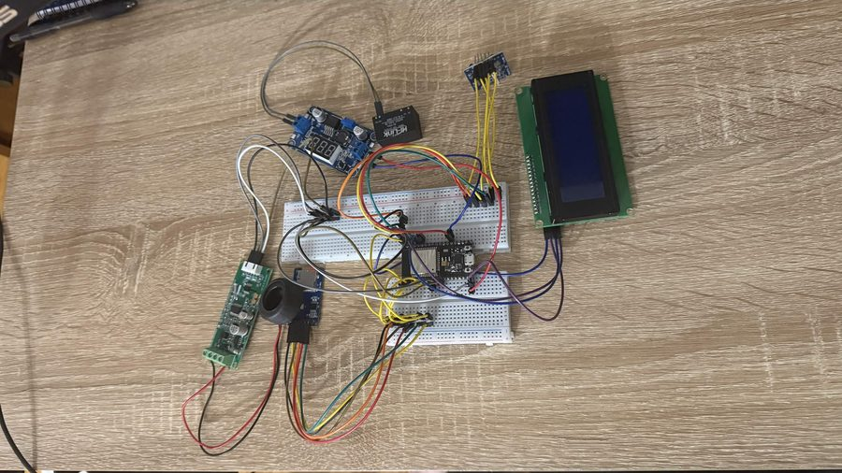
Circuit Build — Prototype
PZEM-004T
Energy Module
ESP32
Dev Board
CT Current
Clamp Sensor
20×4 LCD
Display
By: Dustin Bloss | ETEC-495 | Spring 2026

Slide 5
System Architecture
Power
Grid / Load
ACS712 +
PZEM-004T
ESP32
(Main Board)
ThingSpeak
Cloud
Browser /
Dashboard
›
›
›
›
ADC / UART
I2C
Wi-Fi (HTTP)
20×4 LCD
(I2C)

Slide 6
Software & Firmware
1
Read voltage via GPIO34 ADC → apply voltage divider ratio → real volts
Libraries
• WiFi.h
2
Read current via GPIO35 ADC → subtract 2.5V offset → ÷ sensitivity → amps
• ThingSpeak.h
• LiquidCrystal_I2C.h
3
Calculate Power: P = V × I (watts)
• PZEM004Tv30.h
4
Accumulate Energy: E += P × (Δt / 3600) (watt-hours)
• Wire.h
Key Equations
5
Display V, I, P, Wh on 20×4 LCD via I2C every 500 ms
P = V × I
E += P × (Δt / 3600)
6
Every 15 s — push all 4 values to ThingSpeak cloud over Wi-Fi
V = ADC × 3.3/4095 × ratio
I = (ADC×3.3/4095 − 2.5) / 0.1

Slide 7
Development Journey
Wk 1–2
Planning & Advisor Meeting
Confirmed project scope with Prof. Pavlidis. Selected ESP32 as the single main board for the entire system.
Wk 3
Proposal Submitted
Submitted 1-page proposal with Gantt chart. Ordered parts on Amazon & AliExpress.
Wk 5–7
Sensor Wiring & First Readings
Wired ACS712 and PZEM-004T to the ESP32. Got first successful current and voltage readings.
Wk 7–8
Crisis — ACS712 Fried the ESP32
The ACS712 (HW-670) module caused an overcurrent event that killed the ESP32. Ordered a replacement board immediately.
Wk 8–9
Wiring & Screen Issues
CT clamp was on the wrong conductor — fixed by moving to live wire only. LCD had no display — turned out a jumper wire was missing. Added it and the screen came on.
Wk 9–11
Full Rebuild & Integration
New ESP32 arrived. Rewired cleanly. LCD, PZEM-004T, and ACS712 all working together. ThingSpeak cloud upload confirmed.
Wk 12–14
Testing, Report & Presentation
Final functional testing with known load. Written report completed. PowerPoint and video presentation prepared.

Slide 8
Issues & Solutions
⚠ ACS712 (HW-670) Fried the ESP32
✓ Fix
While wiring the ACS712 current sensor module, an overcurrent event hit the breadboard power rail — the ESP32 completely stopped responding with no USB or serial output.
→
Ordered a replacement ESP32. Added a 1A inline fuse to the power rail. Rewired the ACS712 carefully against the datasheet before re-applying power.
⚠ Wiring Error — CT Clamp on Wrong Wire
✓ Fix
The CT clamp was on the neutral conductor instead of the live wire. The PZEM-004T was reading 0A even with a load connected.
→
Went back to the datasheet. Moved the CT clamp to the live (LINE) wire only. Readings became accurate immediately.
⚠ LCD Screen Not Displaying Anything
✓ Fix
The 20x4 LCD powered on but showed nothing — no backlight, no text. Checked wiring and I2C address — both looked fine.
→
Found that a jumper wire between the I2C backpack and the breadboard was missing. Added the jumper and the screen came on immediately.
⚠ General Wiring Issues During Build
✓ Fix
Multiple loose or incorrect connections throughout the build caused inconsistent readings and occasional resets.
→
Slowed down and verified every connection against the wiring diagram before powering on. Color-coded jumpers helped keep everything organized.

Slide 9
Testing & Results
Test Load: 60W Incandescent Bulb
Measurement | Expected | Measured | Result
Voltage (V) | 120.0 V | 118.3 V | ✓ Pass
Current (A) | ~0.50 A | 0.48 A | ✓ Pass
Power (W) | ~60.0 W | 56.7 W | ✓ Pass
LCD Refresh | 500 ms | ~520 ms | ✓ Pass
ThingSpeak Upload | Every 15s | Every 15s | ✓ Pass
All readings within ±5% of expected values — system performing as designed.

Slide 10
Cost Analysis — Why This Matters
Component | Cost
ESP32 Dev Board (×2 — 1 replacement) | $17.98
PZEM-004T v3.0 Energy Module | $17.99
ACS712 Current Sensor (30A) | $2.50
20×4 LCD Display w/ I2C Adapter | $6.49
Hi-Link 5V Power Module | $8.99
CT Clamp (Current Transformer) | $5.99
Breadboard + Jumper Wires | $13.98
Resistors, Fuse, Misc. | $12.49
My Build
$86.41
Sense®
$299
+ $10/mo subscription
Emporia Vue
$69
+ subscription required
Eyedro Home
$179
+ cloud fees
You save up to $212 upfront — and $0/month forever.
No app. No subscription. No cloud lock-in. Just open data — yours to own.

Slide 11
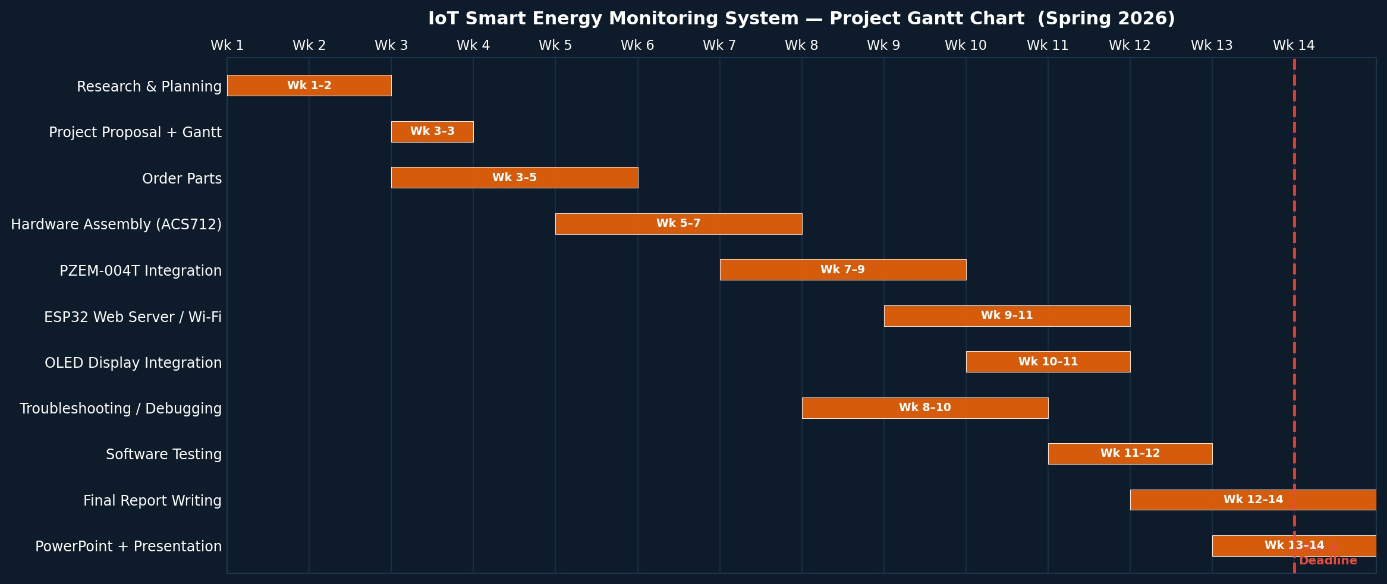
Time & Milestones
57 hrs
88 hrs
+54%
Planned
Actual
Variance
Phase
Planned
Actual
Research & Planning
8 hrs
12 hrs
Ordering Parts
2 hrs
4 hrs
Hardware Assembly
12 hrs
20 hrs
Software Development
15 hrs
18 hrs
Testing & Calibration
8 hrs
10 hrs
Troubleshooting (unplanned)
0 hrs
10 hrs
Report & Presentation
12 hrs
14 hrs
The biggest variance was the 10 unplanned hours of troubleshooting.

Slide 12
Social Impact & Market Analysis
🇺🇸 United States Market
🇮🇳 India Market
• 66M+ smart home households — clear audience
• Fast-growing energy market, 1.4B people
• No subscription fees vs Sense® ($299+)
• High electricity costs drive savings focus
• Open-source DIY appeal on GitHub & Reddit
• 230V / 50Hz compatible out of the box
• YouTube tutorials for organic reach
• Parts available locally (Robu.in, Robocraze)
• Kickstarter/Indiegogo launch strategy
• Aligns with India's RDSS smart metering push

Slide 13
Conclusion & Future Work
What Was Achieved
Future Improvements
✓ Real-time energy monitoring with ESP32 + PZEM-004T
→ Add cloud logging & historical graphs
✓ Live readings on 20×4 LCD display via I2C
→ Mobile app push alerts for power spikes
✓ ThingSpeak cloud dashboard over Wi-Fi
→ Expand to multi-circuit monitoring
✓ Full build under $90 — no subscription needed
→ 3D-printed enclosure for clean install
Thank you | Dustin Bloss | ETEC-495 Spring 2026 | Prof. Lazaros Pavlidis | NYIT

